Slide 1

Hamdard University
Department of Computer Science(FEST)
Final Year Project Proposal
Services Management System

Slide 2
Group Introduction
Members:
Muhammad Areeb Vohra [BSCS/F14/0112]
Abdul Moiz Hussain [BSCS/f14/0128]
Muhammad Taha Amin [BSCS/F14/0117]
Supervisor:
Sir Adnan Ahmed Siddiqui (Assist. Professor)
Co-supervisor:
Sir Muhammad Fahad

Slide 3
Summary
Problem Statement
Motivation
Aims & Objectives
Project Scope (Big Picture & Usage Scenario)
Literature Reviews
Methodology
Project Plan (Gantt Chart & Timeline)
RACI Chart
Project Tools
Budgeting
Project Deliverables
References
Q&A

Slide 4
Problem Statement
In housing societies, problems regarding any household issues like electricity, plumbing, gas leakage, carpentry, fumigation, etc. the person himself has to go and bring the repair man, which takes a lot of time and effort.

Slide 5
Motivation
The proposed project introduces the application which will integrate society’s every problem on a platform, and the problem will be on few clicks away to be solved.

Slide 6
Aims & Objectives
The main objective of this project is to develop a web & smart-phone based application that can be used to inform about any of the household problem in an easier way.
Due to the common use and access of androids and web pages, these platforms are targeted for this project’s UI.
And definitely a web based Service Control Manager, where all the required services of the citizens will be submitted & processed.

Slide 7
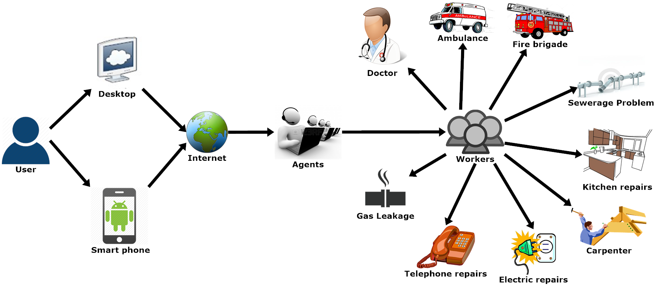
Project Scope (Big Picture)

Slide 8
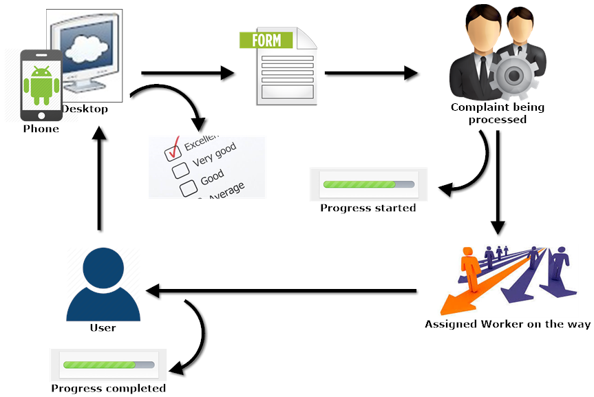
Project Scope (Usage Scenario)

Slide 9
Project Scope
Functional Requirements:
User can request for any service which will be connected to the operator.
Provide accessibility to the android/web application through internet connectivity.
A database that will store the information about the users and workers to be displayed to the operators.
Non-Functional Requirements:
A friendly Graphical User Interface.
An upgradable system, in future if needed.
Availability of android application on Google Play Store, and web application.

Slide 10
Literature Reviews ^{(Continued)}
Study of Implementation of Society Management System ^{[1]}
In this paper, people are notified about every activity of the society through the application.
So, business oriented citizens without much interaction will be able to interact with their society’s daily activities.

Slide 11
Literature Reviews ^{(Continued)}
Ubiquitous Smart Home System Using Android Application ^{[2]}
In this review an android application and an Arduino, as its server, is used to control the appliances of a home.
This methodology can be helpful to control the complaints of the society, by using internet server/domain instead of Arduino, as a connecting medium.

Slide 12
Literature Reviews ^{(Continued)}
Implementation of Society Management System: SOCIETALES^{[3]}
The paper uses online posting of the complaints using android applications for any residential society.
A society has to deal with many complaints involving:
Water supply
Maintenance of electricity etc.
So to manage everything on a single platform would help to maintain a well-defined environment within the society with the help of:
Complaint box
My Complaints
Notice board
Meetings Schedule etc.

Slide 13
Literature Reviews ^{(Continued)}
Ubiquitous Home Control and Monitoring System Using Internet of Things ^{[4]}
This project uses the Internet of Things (IoT) to monitor houses in the society and monitor/control appliances of the house too.
It uses wireless network or 3G/4G to connect 8051 microcontroller as a hosting controller.

Slide 14
Literature Reviews ^{(Continued)}
Implementation of Facility Maintenance Management System using Smart Phone ^{[5]}
This paper proposes an integrated android based mobile application and a web based system that facilitates maintenance management in apartment buildings that saves unnecessary man power that can be used in other aspects.
The methodology of creating an integrated mobile application and web based system is useful to consult the idea of our project.

Slide 15
Literature Reviews (Conclusion)
Reviewed Services:
My Complaints
Push Notifications
Notice Board
Meeting Schedule
Complaint Status
History
Feedback (Reviews & Ratings)

Slide 16
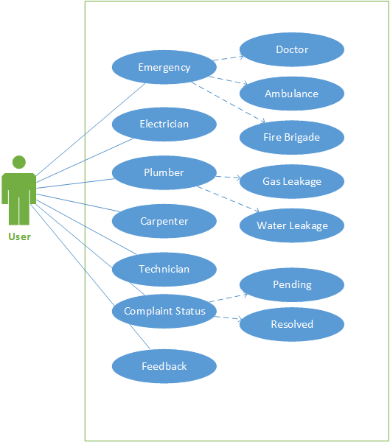
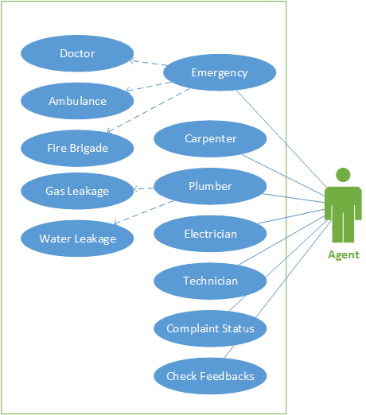
UML Diagrams (Web / Android Applications)

Slide 17
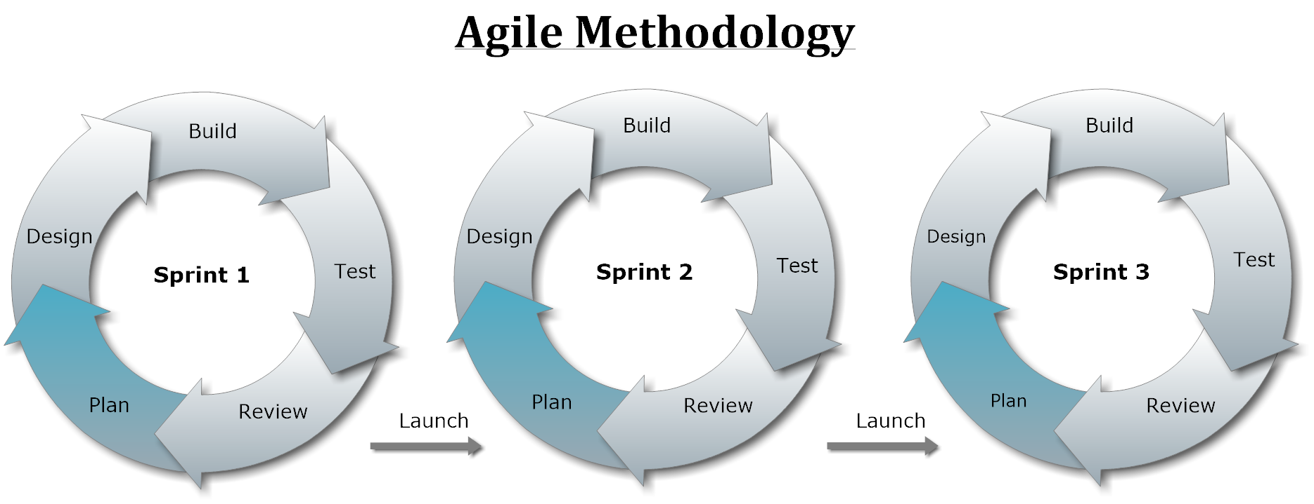
Methodology (Approach)

Slide 18
Project Plan (Gantt Chart)
Task Name | Duration | Start | Finish
FYP Gantt Chart | 132 days | Tue 8/1/17 | Wed 1/31/18
Requirement Analysis | 51 days | Tue 8/1/17 | Tue 10/10/17
Elicitation of Requirement | 51 days | Tue 8/1/17 | Tue 10/10/17
Analysis of Requirement | 51 days | Tue 8/1/17 | Tue 10/10/17
Requirement Validation | 42 days | Mon 8/14/17 | Tue 10/10/17
Designing | 60 days | Mon 9/11/17 | Fri 12/1/17
Web Design | 30 days | Wed 9/27/17 | Tue 11/7/17
Web Application Design | 30 days | Wed 9/27/17 | Tue 11/7/17
Android App Design | 60 days | Mon 9/11/17 | Fri 12/1/17
Implementation | 40 days | Mon 11/20/17 | Fri 1/12/18
Web Development | 20 days | Mon 11/20/17 | Fri 12/15/17
Web Application Development | 20 days | Mon 11/20/17 | Fri 12/15/17
Application Development | 40 days | Mon 11/20/17 | Fri 1/12/18
Testing | 103 days | Mon 9/11/17 | Wed 1/31/18
Black Box Testing | 103 days | Mon 9/11/17 | Wed 1/31/18
White Box Testing | 103 days | Mon 9/11/17 | Wed 1/31/18

Slide 19
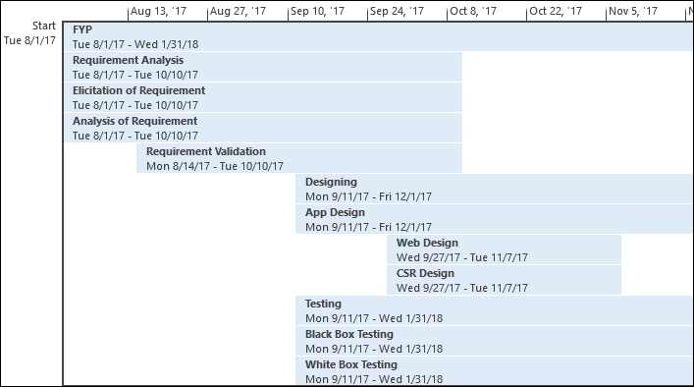
Project Plan (Timeline)^{(continued)}

Slide 20
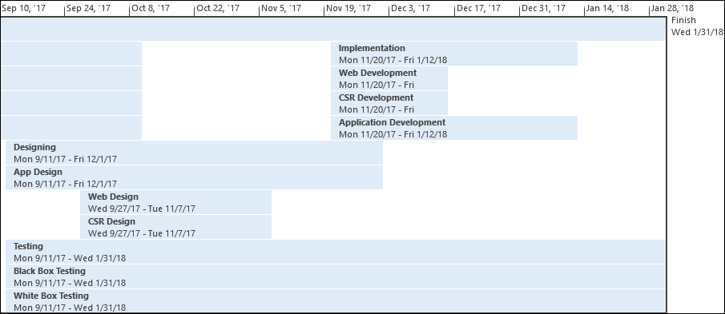
Project Plan (Timeline)

Slide 21
RACI Matrix
Responsibility, Accountability, Consultant, Informed.
 | Taha Amin | Areeb Vohra | Abdul Moiz
Design | R | I,C | A
Analysis | R,I | R | A,C
Development | C,I | R,A | R,C
Testing | A,I | R | A,C

Slide 22
Software Tools
Android Application Development:
Android Studio 2.3
Web Application Development:
WordPress 4.6
Sublime Text 2 (2.0.2)
Database
MySQL 5.5
Documentation:
MS-Office 2013
EndNote 7
Smart Draw 2010
Microsoft Visio 2013
MS-Project 2013

Slide 23
Hardware Tools
Android Mobile – for application testing.
Desktop/Laptop – for Web & Android application development.
Internet (3G/4G) Device – for mobility of internet.

Slide 24
Budget of the Project
Android Mobile ≈ 20,000 PKR
Desktop/Laptop ≈ 25,000 PKR
Internet (3G/4G) device ≈ 4000 PKR
Domain ≈ 3,000 PKR/per annum
Total ≈ 53,000 PKR.

Slide 25
Project Deliverables
First Evaluation:
Design Documents (ERD, Layouts)
Running Website (Admin & User Panel)
Second Evaluation:
Fully functional:
Website
Android Application
Project Report (Including coding documents’ soft copies)

Slide 26
References
Gavhane, Shivganga, Rutuja Vatharkar, Swati Sonar, and Pratiksha Patil. "Study of Implementation of Society Management System." International Journal of Computer Applications 132, no. 1 (2015): 34-36. [PDF] [⇦]
Kumar, Shiu. "Ubiquitous Smart Home System Using Android Application." arXiv preprint arXiv:1402.2114 (2014). [PDF] [⇦]
Vatharkar, Rutuja, Pratiksha Patil, Swati Sonar, and Shivganga Gavhane. "Implementation of Society Management System: Societales.“ [PDF] [⇦]
Kumbhar, Miss Dardi Madhura Rajendra3 Miss, and Amruta Dilip. "Ubiquitous Home Control and Monitoring System Using Internet of Things." (2016). [PDF] [⇦]
Joo, Young-Do. "Implementation of Facility Maintenance Management System Using Smart Phones." The Journal of The Institute of Internet, Broadcasting and Communication 13, no. 1 (2013): 191-97. [PDF] [⇦]

Slide 27
Q&A

Slide 28
Thank you

